Slide 1

AGENDA
Scrum Project: Eco-Factory

Slide 2
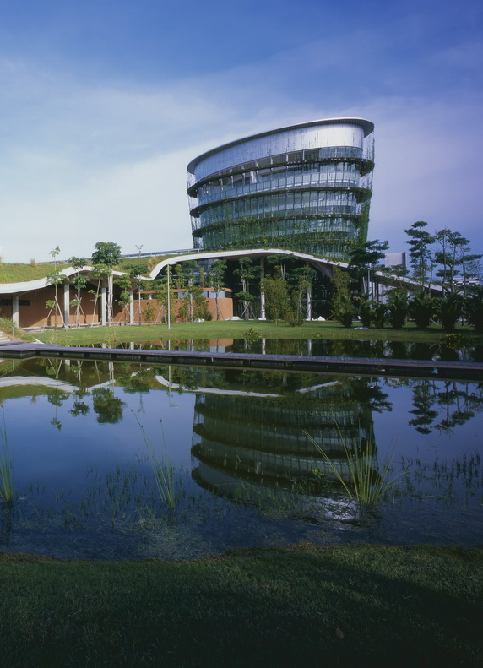
Product Backlog
Factory Building (structure, utilities, machinery)
Employee Housing (apartments, family houses)
Grocery Store
Daycare Center
Sports Center
Sustainability Features (eco-materials, renewable energy)
Roads, Landscaping, and Community Facilities

Slide 3
Sprint 1 (Weeks 1–4): Foundation & Setup
Site preparation & land leveling
Factory foundation work
Housing layout & foundation
Draft design for grocery store & daycare
Sustainability planning (materials, energy source)

Slide 4
Sprint 2 (Weeks 5–8): Construction Progress
Factory walls & structure setup
Install utility lines (electricity, water, solar)
Start grocery store construction
Daycare structure foundation
Roads and pathways planning

Slide 5

Sprint 3 (Weeks 9–12): Completion & Handover
Complete factory interiors (machinery installation, safety)
Finish grocery store, daycare, and sports center
Complete housing units
Landscaping, roads, and community facilities
Testing & final inspection

Slide 6
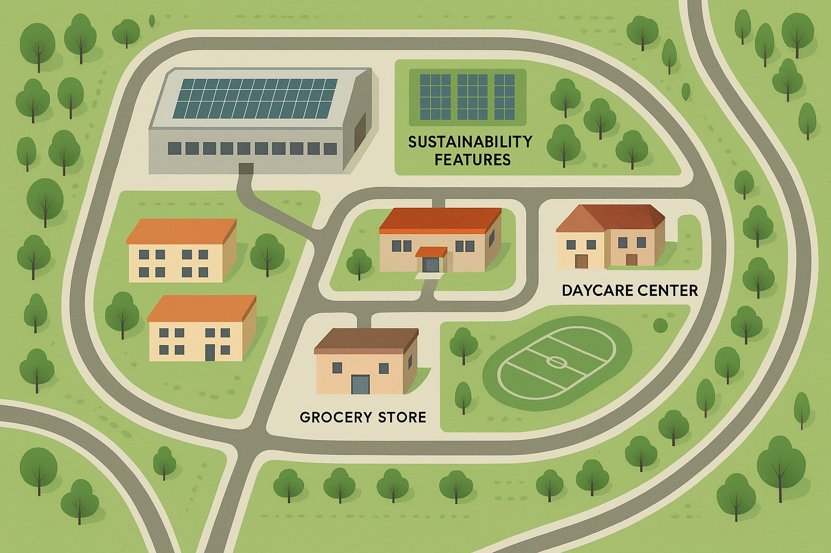
Factory Zone: Central production building with utility access
Housing Area: Employee apartments and family units placed nearby
Grocery Store: Positioned for easy access to housing and factory
Daycare Center: Located in a safe, low-traffic section of the community
Sports Center: Close to housing to encourage daily use
Road Network: Clear separation between pedestrian paths and vehicle
routes
Green Spaces: Parks, trees and open areas across the community
Sustainability Features: Solar panel zones, rainwater collection points

Slide 7

THANK YOU
Scrum Master: Sadia
Product Owner: Sajib
Dev Team: Nihon, Tawheed

